Slide 2
22
The Government
and Fiscal Policy
Chapter Outline
Government in the Economy
Government Purchases (G), Net Taxes (T), and
Disposable income (Y_{d})
Equilibrium Output: Y = C + I + G
Fiscal Policy at Work: Multiplier Effects
The Government Spending Multiplier
The Tax Multiplier
The Balanced-Budget Multiplier
The Federal Budget
The Budget
The Surplus or Deficit
The Debt
The Economy’s Influence on the Government
Budget
Tax Revenues Depend on the State of the Economy
Some Government Expenditures Depend on the
State of the Economy
Automatic Stabilizers
Fiscal Drag
Full-Employment Budget
Looking Ahead
Appendix A: Deriving the Fiscal Policy Multipliers
Appendix B: The Case in Which Tax Revenues
Depend on Income

Slide 3
THE GOVERNMENT AND FISCAL POLICY
fiscal policy The government’s spending and taxing policies.
monetary policy The behavior of the Federal Reserve concerning the nation’s money supply.

Slide 4
GOVERNMENT IN THE ECONOMY
discretionary fiscal policy Changes in taxes or spending that are the result of
deliberate changes in government policy.

Slide 5
GOVERNMENT IN THE ECONOMY
GOVERNMENT PURCHASES (G), NET TAXES (T),
AND DISPOSABLE INCOME (Y_{D})
net taxes (T) Taxes paid by firms and households to the government minus transfer payments made to households
by the government.

Slide 6
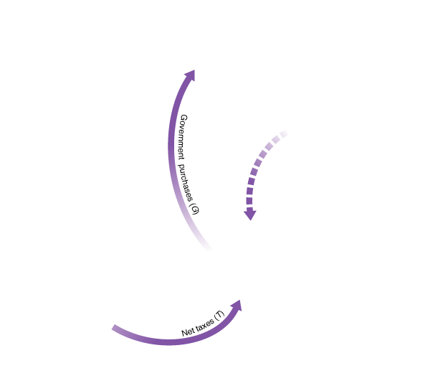
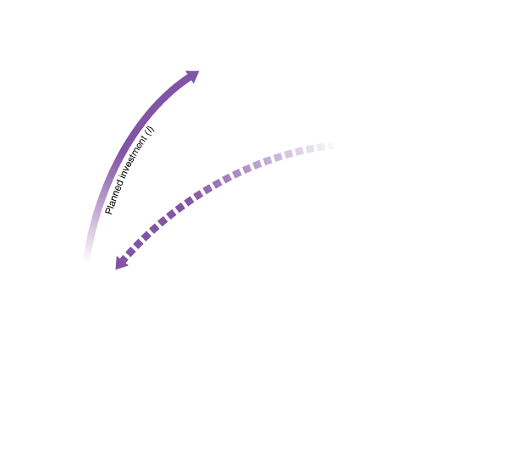
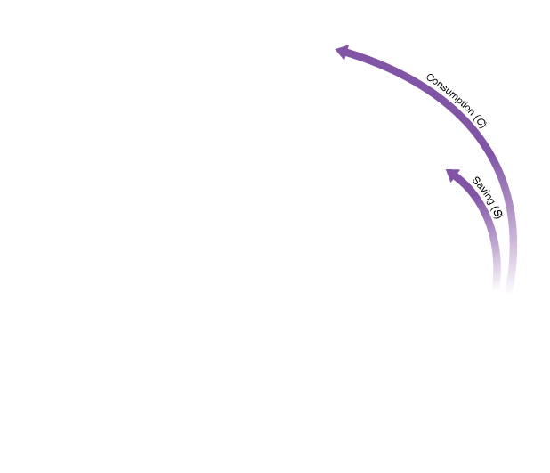
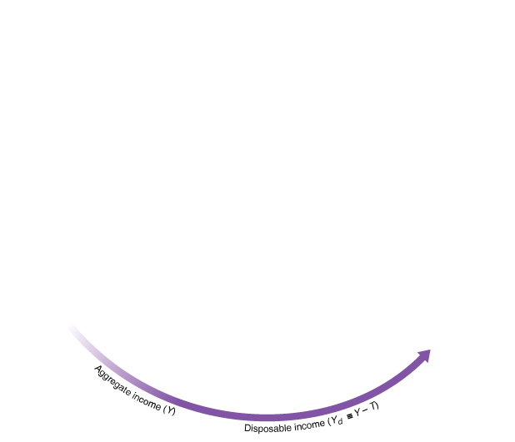
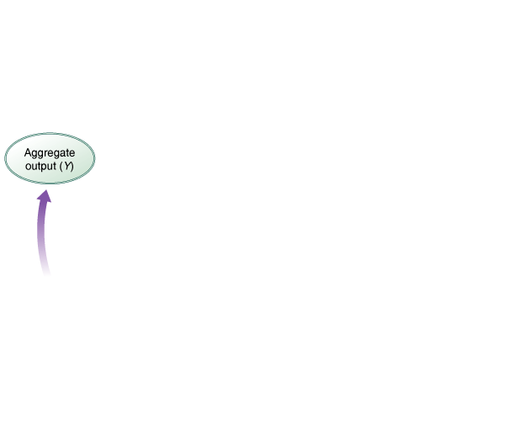
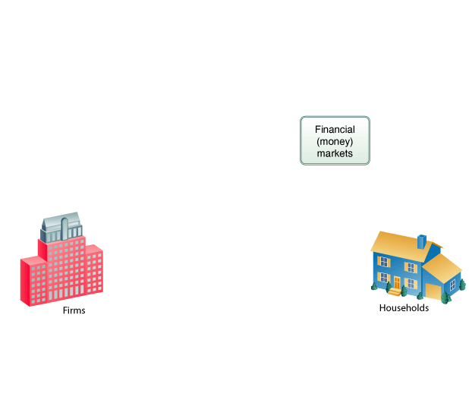

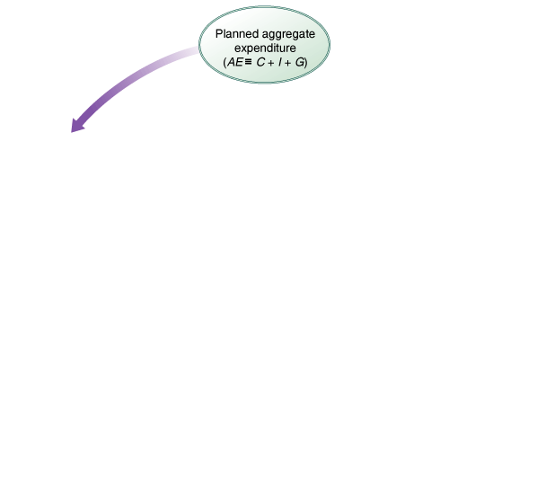
GOVERNMENT IN THE ECONOMY
FIGURE 9.1 Adding Net Taxes (T) and Government Purchases (G) to the Circular Flow of Income

Slide 7
GOVERNMENT IN THE ECONOMY
disposable, or after-tax, income (Y_{d}) Total income minus net taxes: Y − T.
disposable income ≡ total income − net taxes
Y_{d} ≡ Y − T

Slide 8
GOVERNMENT IN THE ECONOMY
When government enters the picture, the aggregate income identity gets cut into three pieces:
And aggregate expenditure (AE) equals:

Slide 9
GOVERNMENT IN THE ECONOMY
budget deficit The difference between what a government spends and what it
collects in taxes in a given period: G − T.
budget deficit ≡ G − T

Slide 10
GOVERNMENT IN THE ECONOMY
Adding Taxes to the Consumption Function
To modify our aggregate consumption function to incorporate disposable income instead of before-tax income, instead of C = a + bY, we write
C = a + bY_{d}
or
C = a + b(Y − T)
Our consumption function now has consumption depending on disposable income instead of before-tax income.

Slide 11
GOVERNMENT IN THE ECONOMY
Investment
The government can affect investment behavior
through its tax treatment of depreciation and other tax policies.

Slide 12
GOVERNMENT IN THE ECONOMY
EQUILIBRIUM OUTPUT: Y = C + I + G
equilibrium condition: Y = C + I + G
TABLE 9.1 Finding Equilibrium for I = 100, G = 100, and T = 100 (All Figures in Billions of Dollars)
(1) | (2) | (3) | (4) | (5) | (6) | (7) | (8) | (9) | (10)
OUTPUT (INCOME) Y | NET TAXES T | DISPOSABLE INCOME Y_{d}  Y − T | CONSUMPTION SPENDING (C = 100 + .75 Y_{d}) | SAVING S (Y_{d} – C) | PLANNED INVESTMENT SPENDING I | GOVERNMENT PURCHASES G | PLANNED AGGREGATE EXPENDITURE C + I + G | UNPLANNED INVENTORY CHANGE Y − (C + I + G) | ADJUSTMENT TO DISEQUILIBRIUM
300 | 100 | 200 | 250 | − 50 | 100 | 100 | 450 | − 150 | Output
500 | 100 | 400 | 400 | 0 | 100 | 100 | 600 | − 100 | Output
700 | 100 | 600 | 550 | 50 | 100 | 100 | 750 | − 50 | Output
900 | 100 | 800 | 700 | 100 | 100 | 100 | 900 | 0 | Equilibrium
1,100 | 100 | 1,000 | 850 | 150 | 100 | 100 | 1,050 | + 50 | Output
1,300 | 100 | 1,200 | 1,000 | 200 | 100 | 100 | 1,200 | + 100 | Output
1,500 | 100 | 1,400 | 1,150 | 250 | 100 | 100 | 1,350 | + 150 | Output

Slide 13
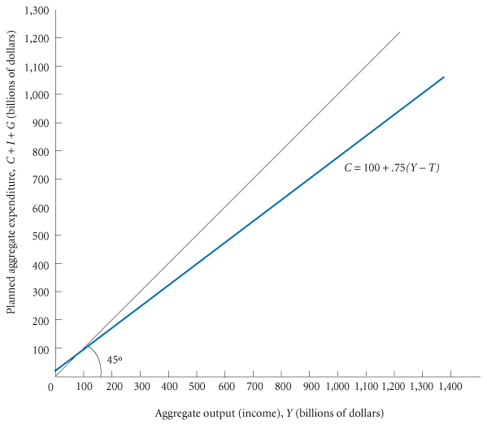
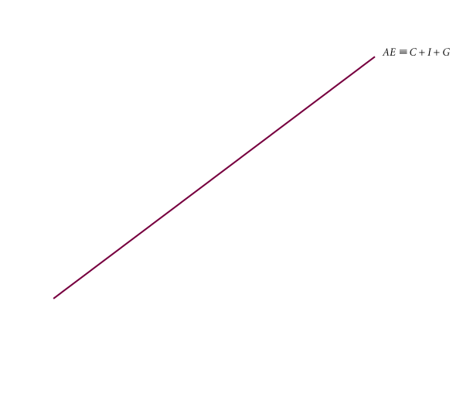
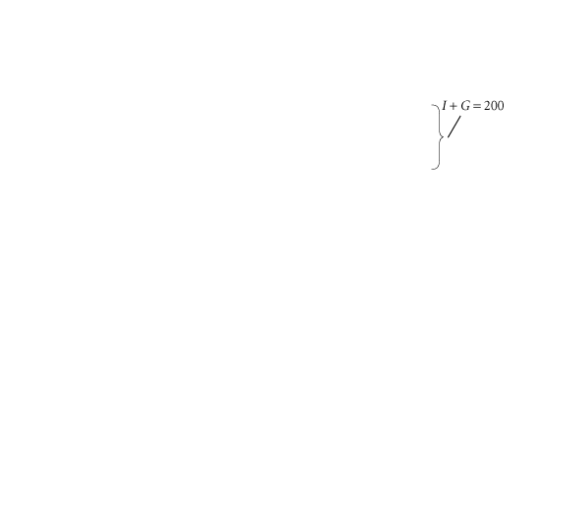
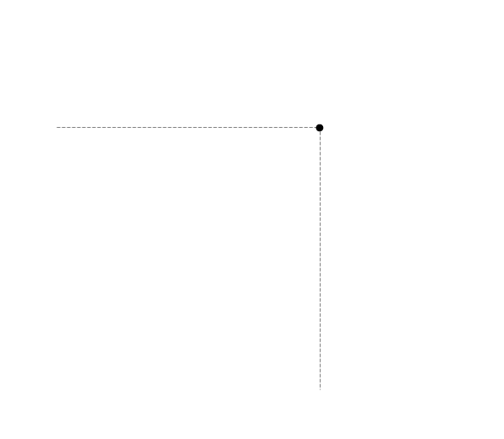
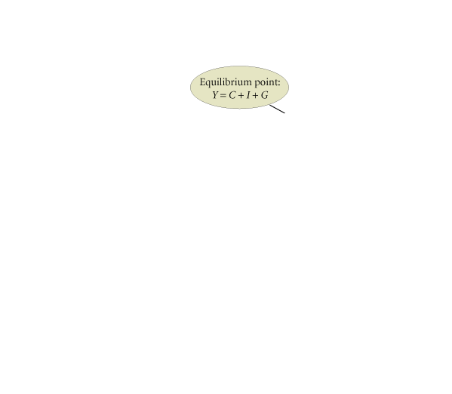
GOVERNMENT IN THE ECONOMY
FIGURE 9.2 Finding Equilibrium Output/Income Graphically

Slide 14
GOVERNMENT IN THE ECONOMY
The Leakages/Injections Approach to Equilibrium
Taxes (T) are a leakage from the flow of income. Saving (S) is also a leakage.
In equilibrium, aggregate output (income) (Y) equals planned aggregate expenditure (AE), and leakages (S + T) must equal planned injections (I + G). Algebraically,
leakages/injections approach to equilibrium: S + T = I + G

Slide 15
FISCAL POLICY AT WORK:
MULTIPLIER EFFECTS
THE GOVERNMENT SPENDING MULTIPLIER
TABLE 9.2 Finding Equilibrium After a $50 Billion Government Spending Increase (All Figures in Billions of Dollars; G Has Increased from 100 in Table 9.1 to 150 Here)
(1) | (2) | (3) | (4) | (5) | (6) | (7) | (8) | (9) | (10)
OUTPUT (INCOME) Y | NET TAXES T | DISPOSABLE INCOME Y_{d}  Y − T | CONSUMPTION SPENDING (C = 100 + .75 Y_{d}) | SAVING S (Y_{d} – C) | PLANNED INVESTMENT SPENDING I | GOVERNMENT PURCHASES G | PLANNED AGGREGATE EXPENDITURE C + I + G | UNPLANNED INVENTORY CHANGE Y − (C + I + G) | ADJUSTMENT TO DISEQUILIBRIUM
300 | 100 | 200 | 250 | − 50 | 100 | 150 | 500 | − 200 | Output
500 | 100 | 400 | 400 | 0 | 100 | 150 | 650 | − 150 | Output
700 | 100 | 600 | 550 | 50 | 100 | 150 | 800 | − 100 | Output
900 | 100 | 800 | 700 | 100 | 100 | 150 | 950 | − 50 | Output
1,100 | 100 | 1,000 | 850 | 150 | 100 | 150 | 1,100 | 0 | Equilibrium
1,300 | 100 | 1,200 | 1,000 | 200 | 100 | 150 | 1,250 | + 50 | Output

Slide 16
FISCAL POLICY AT WORK:
MULTIPLIER EFFECTS
government spending multiplier The ratio of the change in the equilibrium level of output to a change in government spending.

Slide 17
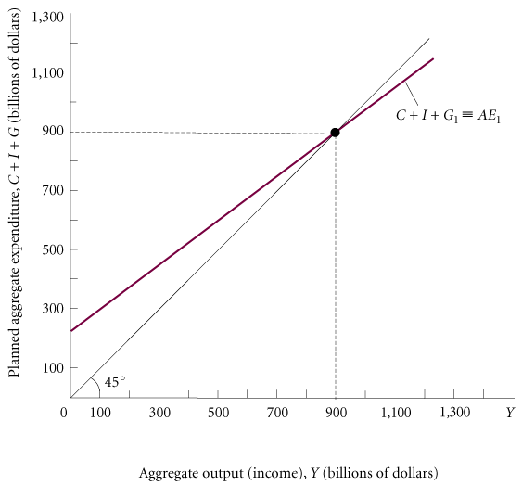
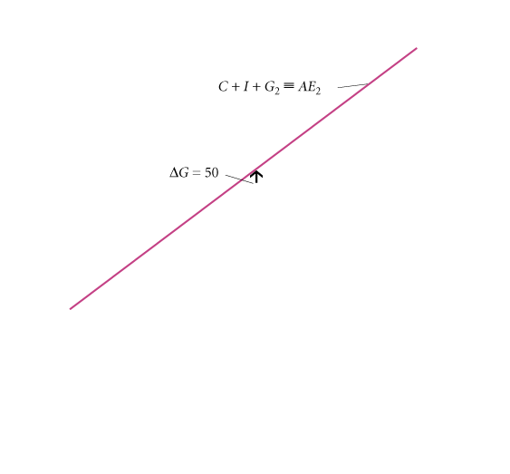
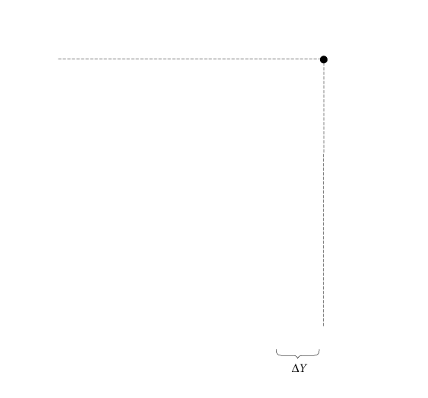
FISCAL POLICY AT WORK:
MULTIPLIER EFFECTS
FIGURE 9.3 The Government Spending Multiplier

Slide 18
FISCAL POLICY AT WORK:
MULTIPLIER EFFECTS
THE TAX MULTIPLIER
The multiplier for a change in taxes is not the same as the multiplier for a change in
government spending.
tax multiplier The ratio of change in the equilibrium level of output to a change in taxes.

Slide 19
FISCAL POLICY AT WORK:
MULTIPLIER EFFECTS

Slide 20
FISCAL POLICY AT WORK:
MULTIPLIER EFFECTS
THE BALANCED-BUDGET MULTIPLIER
balanced-budget multiplier The ratio of change in the equilibrium level of output to a change in government
spending where the change in government spending is balanced by a change in taxes so as not to create any deficit. The balanced-budget multiplier is equal to 1: The change in Y resulting from the change in G and the equal change in T is exactly the same size as the initial change in G or T itself.

Slide 21
FISCAL POLICY AT WORK:
MULTIPLIER EFFECTS
An increase in government spending has a direct initial effect on planned aggregate expenditure; a tax increase does not. The initial effect of the tax increase is that households cut consumption by the MPC times the change in taxes. This change in
consumption is less than the change in taxes, because the MPC is less than 1. The
positive stimulus from the government spending increase is thus greater than the
negative stimulus from the tax increase. The net effect is that the balanced-budget
multiplier is 1.

Slide 22
FISCAL POLICY AT WORK:
MULTIPLIER EFFECTS
TABLE 9.3 Finding Equilibrium After a $200-Billion Balanced-Budget Increase in G and T (All Figures in Billions of Dollars; Both G and T Have Increased from 100 in Table 9.1 to 300 Here)
(1) | (2) | (3) | (4) | (5) | (6) | (7) | (8) | (9)
OUTPUT (INCOME) Y | NET TAXES T | DISPOSABLE INCOME Y_{d}  Y − T | CONSUMPTION SPENDING (C = 100 + .75 Y_{d}) | PLANNED INVESTMENT SPENDING I | GOVERNMENT PURCHASES G | PLANNED AGGREGATE EXPENDITURE C + I + G | UNPLANNED INVENTORY CHANGE Y − (C + I + G) | ADJUSTMENT TO DISEQUILIBRIUM
500 | 300 | 200 | 250 | 100 | 300 | 650 | − 150 | Output
700 | 300 | 400 | 400 | 100 | 300 | 800 | − 100 | Output
900 | 300 | 600 | 550 | 100 | 300 | 950 | − 50 | Output
1,100 | 300 | 800 | 700 | 100 | 300 | 1,100 | 0 | Equilibrium
1,300 | 300 | 1,000 | 850 | 100 | 300 | 1,250 | + 50 | Output
1,500 | 300 | 1,200 | 1,000 | 100 | 300 | 1,400 | + 100 | Output

Slide 23
FISCAL POLICY AT WORK:
MULTIPLIER EFFECTS
TABLE 9.4 Summary of Fiscal Policy Multipliers
 | POLICY STIMULUS | MULTIPLIER | FINAL IMPACT ON EQUILIBRIUM Y
Government- spending multiplier | Increase or decrease in the level of government purchases:
Tax multiplier | Increase or decrease in the level of net taxes:
Balanced-budget multiplier | Simultaneous balanced-budget increase or decrease in the level of government purchases and net taxes: | 1

Slide 24
THE FEDERAL BUDGET
federal budget The budget of the federal government.

Slide 25
THE FEDERAL BUDGET
THE BUDGET
TABLE 9.5 Federal Government Receipts and Expenditures, 2004 (Billions of Dollars)
 |  |  | AMOUNT | PERCENTAGE OF TOTAL
Receipts
 | Personal income taxes |  | 801.8 | 40.6
 | Excise taxes and custom duties |  | 94.0 | 4.8
 | Corporate income taxes |  | 217.4 | 11.0
 | Taxes from the rest of the world |  | 9.2 | 0.5
 | Contributions for social insurance |  | 802.5 | 40.6
 | Interest receipts and rents and royalties |  | 21.9 | 1.1
 | Current transfer receipts from business and persons |  | 28.6 | 1.4
 | Current surplus of government enterprises |  | − 0.5 | 0.0
 |  | Total | 1,974.8 | 100.0
Current Expenditures
 | Consumption expenditures |  | 725.7 | 30.5
 | Transfer payments to persons |  | 1,014.0 | 42.6
 | Transfer payments to the rest of the world |  | 28.9 | 1.2
 | Grants-in-aid to state and local governments |  | 348.3 | 14.6
 | Interest payments |  | 221.5 | 9.3
 | Subsidies |  | 43.0 | 1.8
 |  | Total | 2,381.3 | 100.0
Net federal government saving—surplus (+) or deficit (−) (total current receipts − total current expenditures) |  |  | − 406.5
Source: U.S. Department of Commerce, Bureau of Economic Analysis.

Slide 26
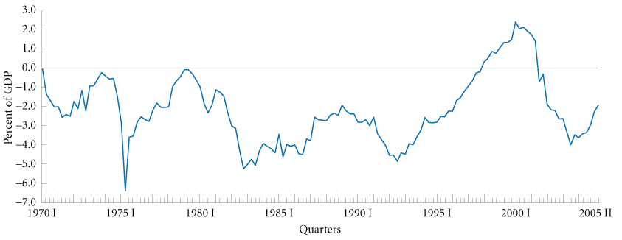
THE FEDERAL BUDGET
THE SURPLUS OR DEFICIT
federal surplus (+) or deficit (−) Federal government receipts minus expenditures.
FIGURE 9.4 The Federal Government Surplus (+) or Deficit (−) as a Percentage of GDP, 1970 I–2005 II

Slide 27
THE FEDERAL BUDGET
THE DEBT
federal debt The total amount owed by the federal government.
privately held federal debt The privately held (nongovernment- owned) debt of the U.S. government.

Slide 28
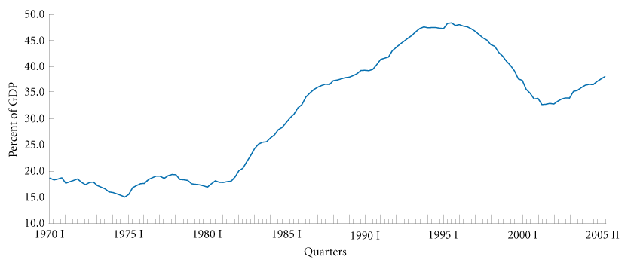
THE FEDERAL BUDGET
FIGURE 9.5 The Federal Government Debt as a Percentage of GDP, 1970 I–2005 II

Slide 29
THE ECONOMY’S INFLUENCE
ON THE GOVERNMENT BUDGET
TAX REVENUES DEPEND ON THE STATE OF THE ECONOMY
Tax revenue depends on taxable income, and income depends on the state of the economy, which the government does not control.

Slide 30
THE ECONOMY’S INFLUENCE
ON THE GOVERNMENT BUDGET
SOME GOVERNMENT EXPENDITURES DEPEND
ON THE STATE OF THE ECONOMY
Transfer payments tend to go down automatically during an expansion.
Inflation often picks up when the economy is expanding. This can lead the government to spend more than it had planned to spend.
Any change in the interest rate changes government interest payments.

Slide 31
THE ECONOMY’S INFLUENCE
ON THE GOVERNMENT BUDGET
AUTOMATIC STABILIZERS
automatic stabilizers Revenue and expenditure items in the federal budget that automatically change with the state of the economy in such a way as to stabilize GDP.

Slide 32
THE ECONOMY’S INFLUENCE
ON THE GOVERNMENT BUDGET
FISCAL DRAG
fiscal drag The negative effect on the economy that occurs when average tax rates increase because taxpayers have moved into higher income brackets during an expansion.

Slide 33
THE ECONOMY’S INFLUENCE
ON THE GOVERNMENT BUDGET
FULL-EMPLOYMENT BUDGET
full-employment budget What the federal budget would be if the economy were producing at a full-employment level of output.
structural deficit The deficit that remains at full employment.
cyclical deficit The deficit that occurs because of a downturn in the business cycle.

Slide 34
REVIEW TERMS AND CONCEPTS
automatic stabilizers
balanced-budget multiplier
budget deficit
cyclical deficit
discretionary fiscal policy
disposable, or after-tax, income (Y_{d})
federal budget
federal debt
federal surplus (+) or deficit (−)
fiscal drag
fiscal policy
full-employment budget
government spending multiplier
monetary policy
net taxes (T)
privately held federal debt
structural deficit
tax multiplier
1. Disposable income Yd ≡ Y − T
2. AE ≡ C + I + G
3. Government budget deficit ≡ G − T
4. Equilibrium in an economy with government: Y = C + I + G
5. Leakages/injections approach to equilibrium in an economy with government: S + T = I + G
6. Government spending multiplier ≡
7. Tax multiplier ≡
8. Balanced-budget multiplier ≡ 1

Slide 35
Appendix A
DERIVING THE FISCAL POLICY MULTIPLIERS
THE GOVERNMENT SPENDING AND TAX
MULTIPLIERS

Slide 36
Appendix A
THE BALANCED-BUDGET MULTIPLIER
The balanced-budget multiplier is found by combining the effects of government spending and taxes:
increase in spending:
- decrease in spending:
= net increase in spending
In a balanced-budget increase, ΔG = ΔT, so we can substitute:
net initial increase in spending:
ΔG − ΔG (MPC) = ΔG (1 − MPC)

Slide 37
Appendix A
Because MPS = (1 − MPC), the net initial increase in spending is:
ΔG (MPS)
We can now apply the expenditure multiplier
to this net initial increase in spending:

Slide 38
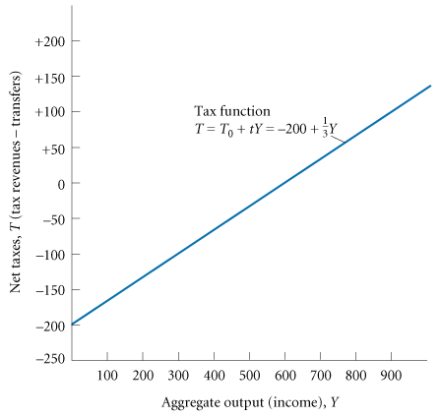
Appendix B
THE CASE IN WHICH TAX REVENUES DEPEND ON INCOME
FIGURE 9B.1 The Tax Function

Slide 39
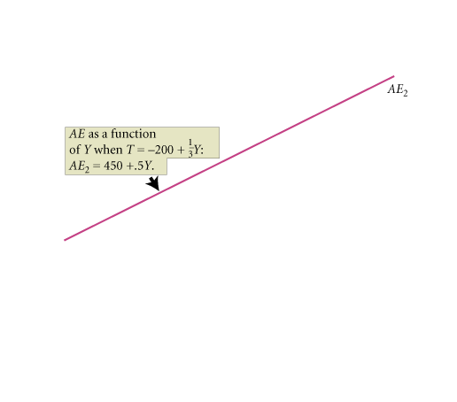
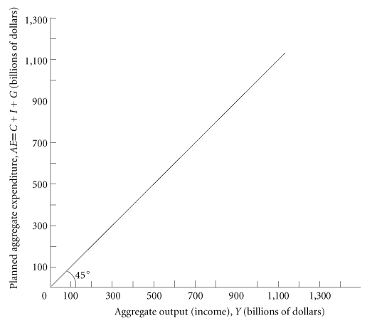
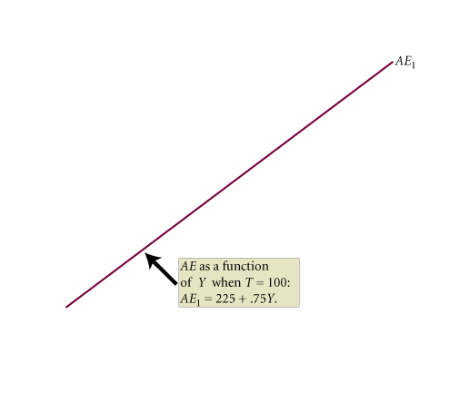
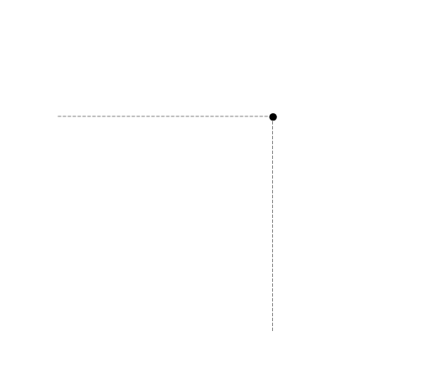
Appendix B
FIGURE 9B.2 Different Tax Systems

Slide 40
Appendix B
THE GOVERNMENT SPENDING AND TAX
MULTIPLIERS ALGEBRAICALLY

